Slide 1
The land price increase prediction in Osaka city in Japan
Takahiro Yoshii 8/11/2020

Slide 2
Introduction
During the COVID pandemic, there are many people lost their job or faced decrease of their salary. In order to increase one's income, real estate investment is one option. Under COVID pandemic situation, some people decide to release their property due to financial difficulties so that this is the best timing to invest on real estate! When you are really investing on real estate, you would like to know where will rise its value most. Here we focus on Osaka city because it is expected to grow where Olympic and Expo are scheduled. Originally Osaka area is well known for its historical and commercial value in Japan.

Slide 3
Data
Data source(sorry some data sources are in Japanese)
1.Land price data in 2020,2015
(https://nlftp.mlit.go.jp/ksj/gml/datalist/KsjTmplt-L01-v2_5.html)
2.venue information(https://ja.foursquare.com/city-guide)
My target is to predict the price change ratio from 2010 which I obtained information from Data.1 Land price is mainly determined by its environment. For venue information I obtained from Data1 and Data2 By using Foursquare API, I obtain information of venues around the location.(in this case we chose 500m which is around 10 min walk). And additional information such as distance from the closest station is obtained from Data1

Slide 4
Data cleansing
In the data cleansing section, I got one hot coding based on venue categories and the total number of venues registered in "Foursquare" because the land price and the number of venues seem to be connected. Also the kinds of shops should be related to the land price.

Slide 5
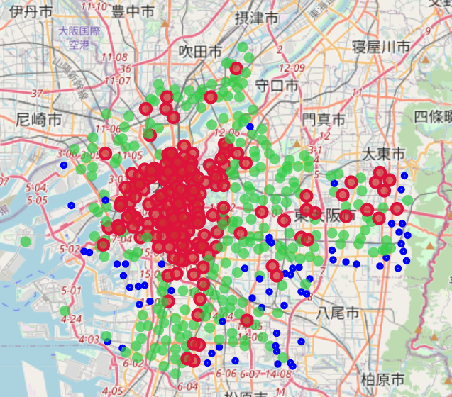
Data exploration Geographical insight
Land price change
●<100%
●100%<105%
●105%<
the center of the city is mainly red and surrounded by green circles.
⇒The city center is growing so that its land price increased.
⇒Spread around for a more reasonable price so that the land price outside of city center areas increased as well. Blue circle areas are mainly on the southeast and west side.
⇒Port area losing importance
⇒The city expands to the north

Slide 6
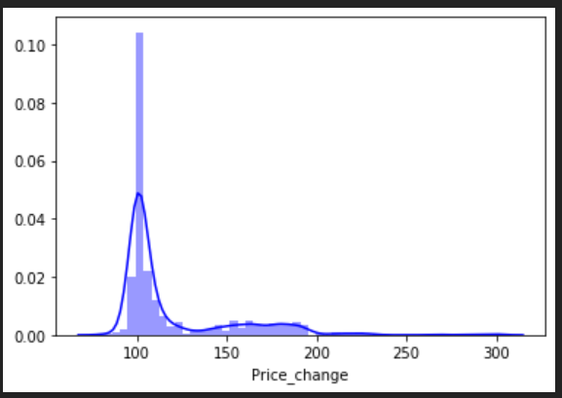
Data exploration Numerical insight
Histogram of Price change during 2015 to 2020
There are two peaks.
103% which means the land price slightly increased the same as five years ago.
170% which means the land price increased by 70% since 2015
⇒There are two mode in price change

Slide 7
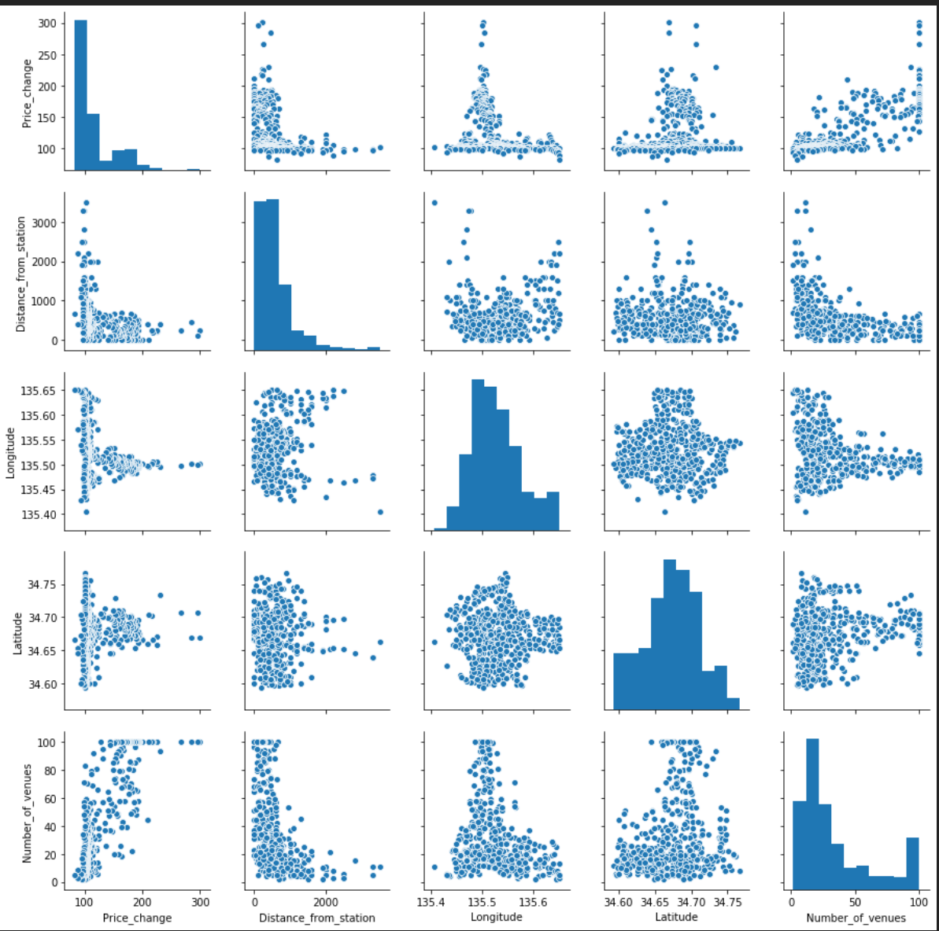
Data exploration Numerical insight
Pair plot
(Price chang vs. distance from station, location, number of venues)
The land price tends to increase when the distance from a station.
City center tends to increase the land price.
The relation between a price change and the number of venues seems to have exponential relation.

Slide 8
Methodology
Algorithms(From sklearn:https://scikit-learn.org/stable/)
Support vector machine(SVM)
Elastic net regression
Random forest regression
Hyperparameter optimize(From sklearn:https://scikit-learn.org/stable/)
GridSearchCV

Slide 9
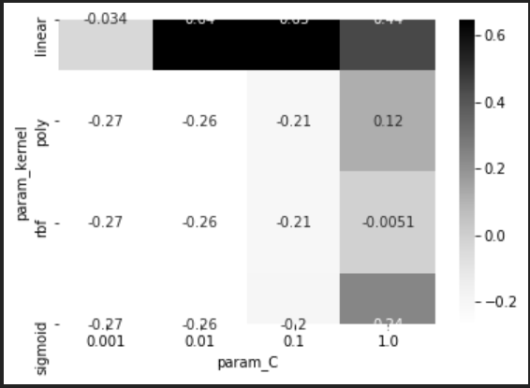
Results Suppot vector machine
Heat map of hyperparameter optimization
Best score
Test set score: 0.6200988623230796
Best parameters: {'C': 0.1, 'kernel': 'linear'}
Best cross-validation: 0.6469076950459205

Slide 10
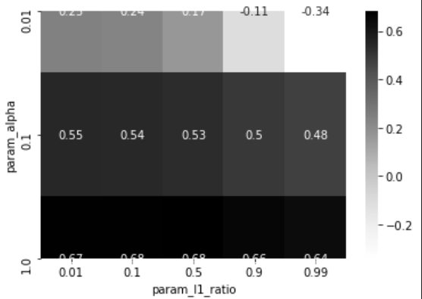
Results Elastic net regression
Heat map of hyperparameter optimization
Best score
Test set score: 0.6976452767261659
Best parameters: {'alpha': 1, 'l1_ratio': 0.5}
Best cross-validation: 0.6809995620508674

Slide 11
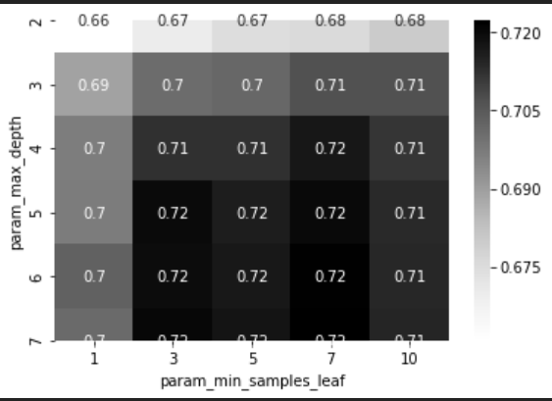
Results Random forest regression
Heat map of hyperparameter optimization
Best score
Test set score: 0.7015920479964228
Best parameters: {'max_depth': 7, 'min_samples_leaf': 7}
Best cross-validation: 0.7221997056564007

Slide 12
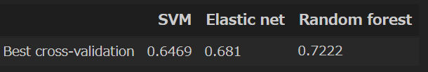
Results Comparison of three algorithms
Random forest was the fittest algorithm

Slide 13
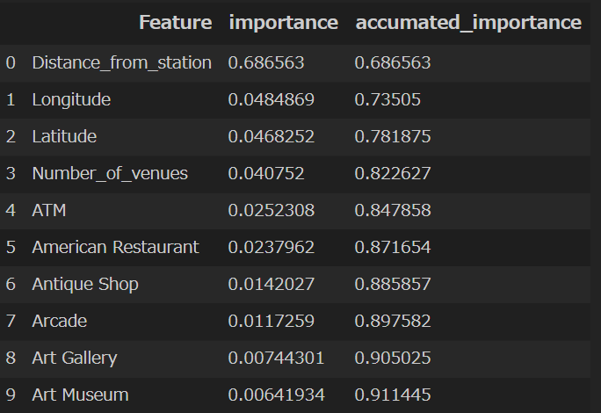
Discussion
Accessibility
Better accessibly attracted more people
Location
Concentration on originally popular places
Number of venues
Commercial areas
Others
Wealthy neighbourhood

Slide 14
Conclusion
In this report, I investigate the land price increase over the last five years with geographical features, accessibility, and venue information using Random forest regression. I found there are 4 factors to increase the land price, accessibility, city center, number of venues, and wealthy neighborhood. And I got high predictability( 0.7222 ). I will use this insight to invest next time.

Slide 15
Thank you for marking!!
I appreciate you feedback!
I hope my research give you some new insight!

